Slide 1
6/18/21
Annual Conference

Slide 2
Speakers
Melissa Pond,
City of Quincy, Massachusetts; NCDA
Elizabeth McNanny,
City of Caldwell, Idaho
Marcy Esbjerg,
Pasco County, Florida

Slide 3
Asking Questions and Commenting
Type your questions for speakers in the Q & A box and I will direct them to the speakers as your moderator.
If you have general questions or comments or just want to say hello, please use the chat feature.

Slide 4
Melissa Pond City of Quincy, mA
Training & Networking Events
Collaborations & Partnerships
Communications Access

Slide 5
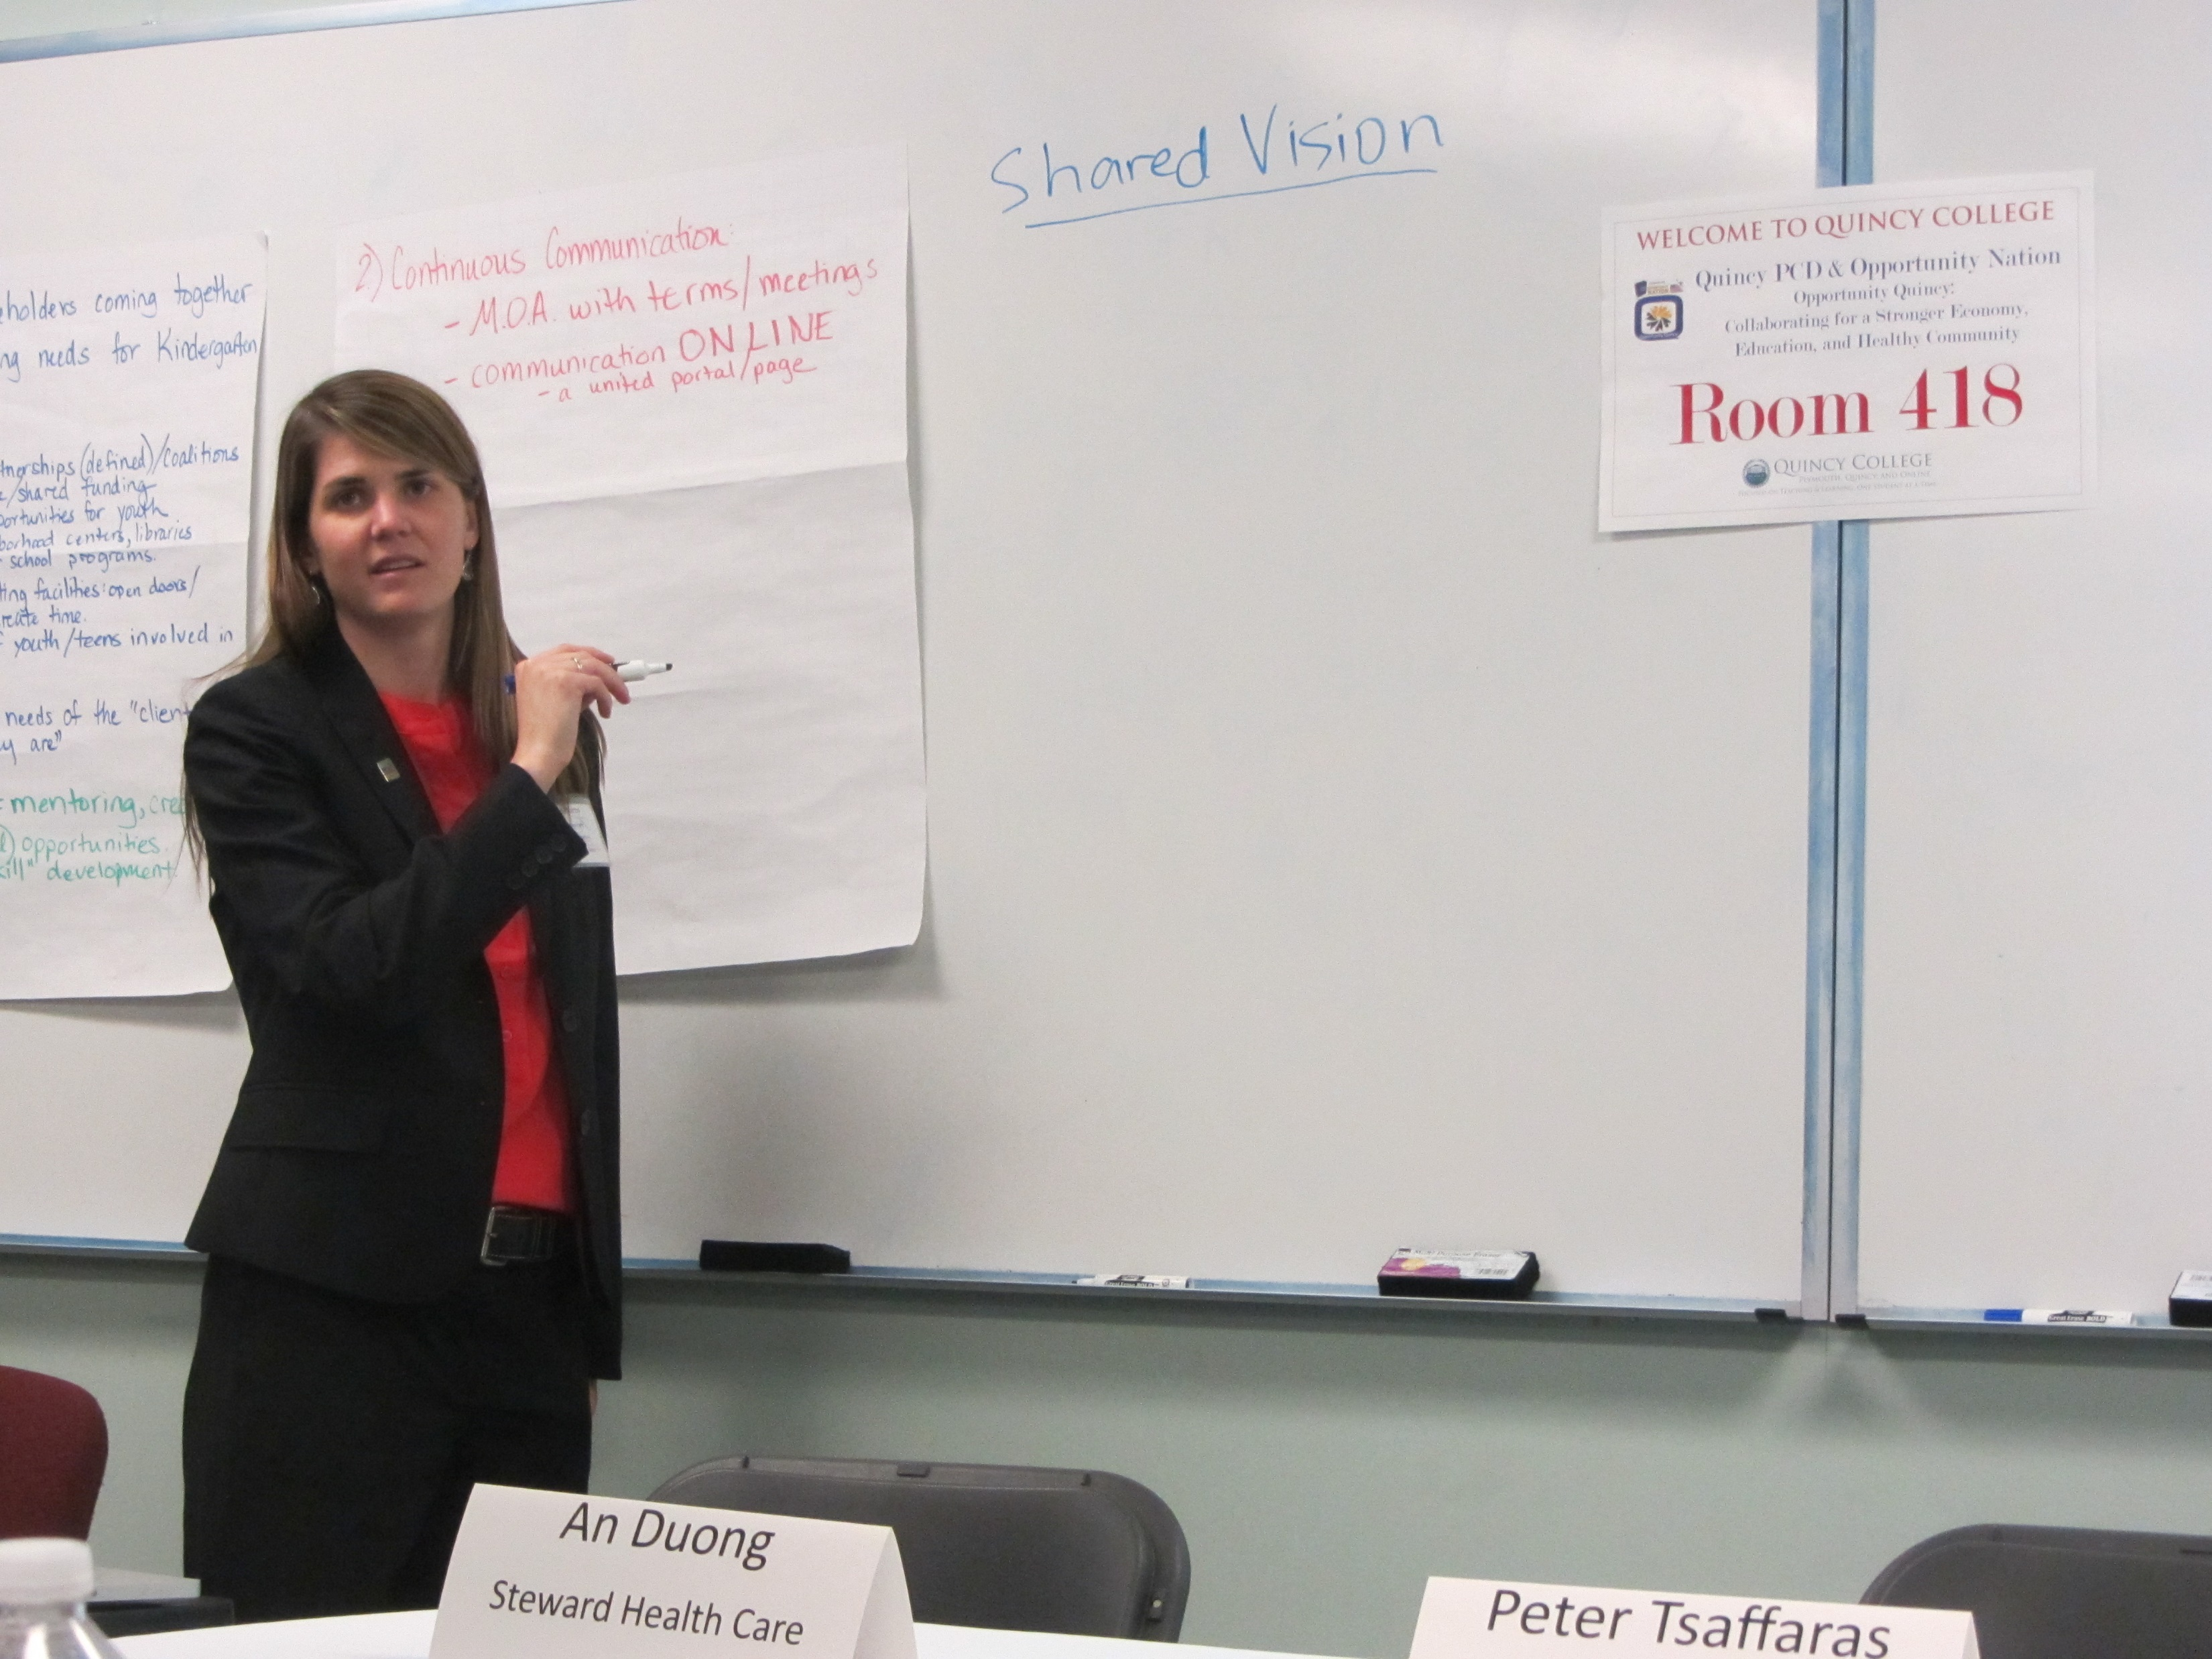
Training & Networking Events
Annual Symposium:
Five Year Plan
Transportation & Health
Inclusion & Disabilities
Literacy & Screen Time
Childhood Health Social Media
Opportunity Index
Outcome Measurement
Volunteerism
Notes:
Challenges: not all training and networking opportunities apply to all vendors
Opportunities: Focus on high-level, mutual goals (bipartisan, opportunity, state or national frameworks, volunteerism, grant-writing, environmental factors…)
Community Development Symposium: Engagement tool to bring together public service agencies for a region-wide dialogue on a specific topic related to community development

Slide 6
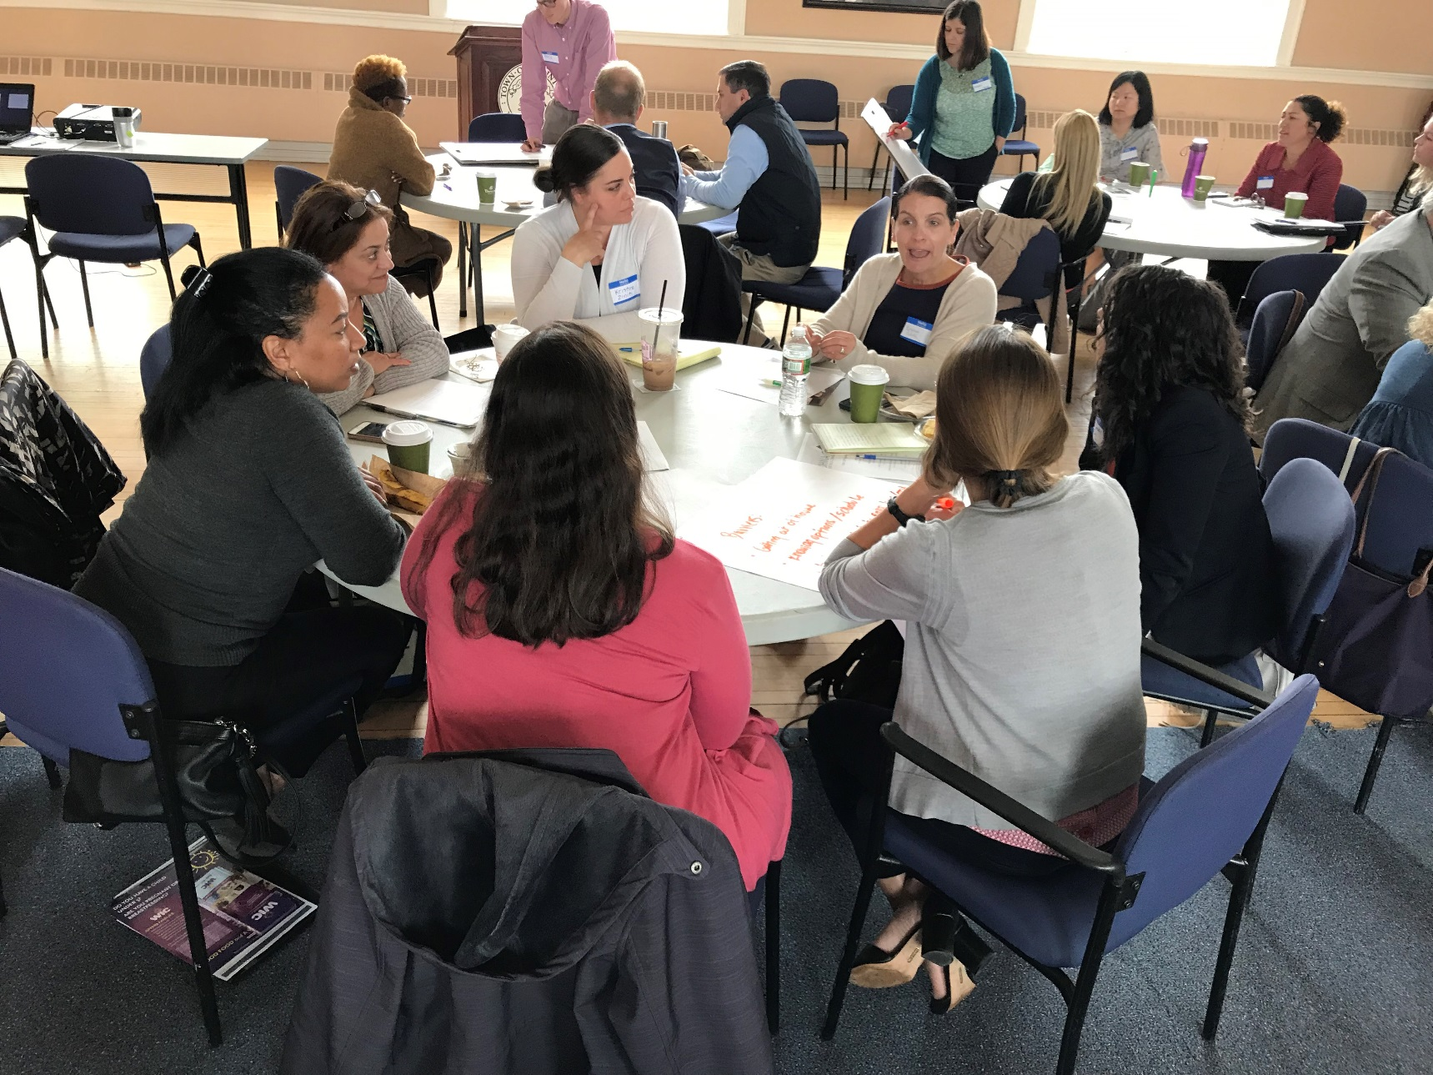
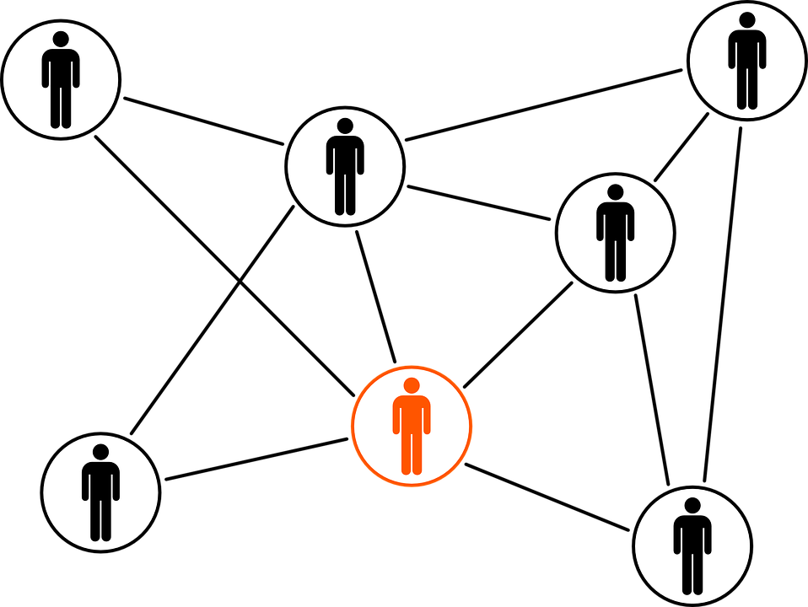
Collaborations & Partnerships
Notes:
Challenges: Data sharing; funding sources that require collaboration and partnership; competition
Opportunities: participate in local established community collaborations for example, South Shore Hunger Network, Community Health Network Alliance, & Coordinated Family and Community Engagement (CFCE); Referral and referral follow-up; formal agreements with memorandums of understanding; funding opportunities; establish relationships and potential projects ahead of funding opportunities

Slide 7
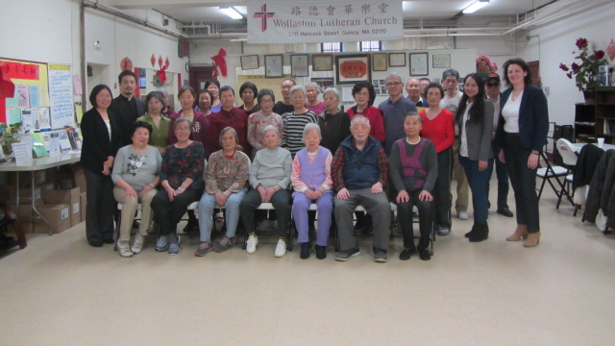
Communications Access
Notes:
Challenges: Most vulnerable groups need more assistance with communications support (persons with disabilities, persons with limited English proficiency); Google Translate not considered meaningful access as determined by Department of Justice
Opportunities: Fund interpreters, translators, CART services; work with Commission on Disabilities, cultural/immigration service providers; hire diverse staff

Slide 8
Q & A

